Slide 1

Materials Uniformity and Quality Control
PPE Course

Slide 2
Objectives
Understand quality indicators from legacy Holcim and Lafarge
Be able to use quality data for root cause analysis
Be aware of cost impacts of inadequate uniformity
Know effective quality control measures
2

Slide 3
Agenda
Introduction
5
Quality and Uniformity Targets
10
Evaluation of uniformity
23
Cost Impact of Insufficient Uniformity
52
How to improve uniformity
67
Quality Control Aspects of Uniformity
75
Summary and Conclusions
85

Slide 4
Introduction

Slide 5
Importance of kiln feed uniformity
Accused in the context of:
kiln commissioning
low kiln availability
low kiln production rate
high refractory wear
limited AFR utilisation
clinker/cement
quality deficiencies
There is a great potential to exploit!
5

Slide 6
Targets and Uniformity: Objectives
Cost effective processing of materials requires:
Appropriate targets for relevant material properties
High uniformity of material properties
Deviations from targets and excessive variations lead to higher production costs and final product deficiencies
→ Non-Quality Costs
6

Slide 7
Relevant material properties
Process | Material | Relevant materials properties for process and quality
Quarrying | Raw components | Major elements: SiO₂, Al₂O₃, Fe₂O₃, CaO Minor elements: alk., SO₃, Cl, MgO, TOC Mineralogical composition: quartz Moisture
Storage/ Preblending | Components, blended components | Major elements: SiO₂, Al₂O₃, Fe₂O₃, CaO Minor elements: alkalis, SO₃, Cl, MgO Mineralogical composition: quartz Granulometry
Raw meal grinding | Raw meal | Major elements: LS, SR, AR (alkali) Minor elements: alk., SO₃, Cl, MgO, TOC Mineralogical composition: quartz Fineness: R90μm
red: only place to control gray: limited or no direct control possibility
7

Slide 8
Relevant material properties
Process | Material | Relevant materials properties for process and quality
Clinker burning | Kiln feed | Major elements: LS, SR, AR (alk.) Minor elements: alk., SO3, Cl, MgO, TOC Mineralogical composition: quartz Fineness: R90μm
 | Fuels, AFR | Fineness Calorific value S, Cl, others
 | Clinker | Free lime Major elements: LS, SR, AR (alk.) Clinker phases: C₃S, C₂S, C₃A, C₄AF
Cement grinding | Cement/ Mortar | Fineness: Blaine, R45μm, SO₃ Strength
8

Slide 9
Quality and Uniformity Targets

Slide 10
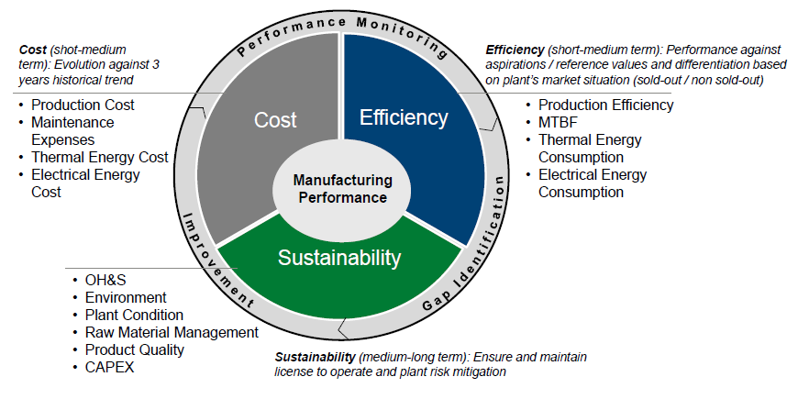
Legacy Holcim Performance Radar: Product uniformity was part of it
10

Slide 11
Six (potential) quality indicators for performance monitoring
Index | Indicator
Product Quality Index | 1 | Measurement of customer satisfaction
 | 2 | Product performance benchmarking against competitors
 | 3 | Clinker factor (new)
 | 4 | Product compliance to internal product specifications
 | 5 & 6 | Manufacturing quality targets and KPIs
 | 7 | Lab methods mastery (new)
Responsibility:
Marketing
Manufacturing
11

Slide 12
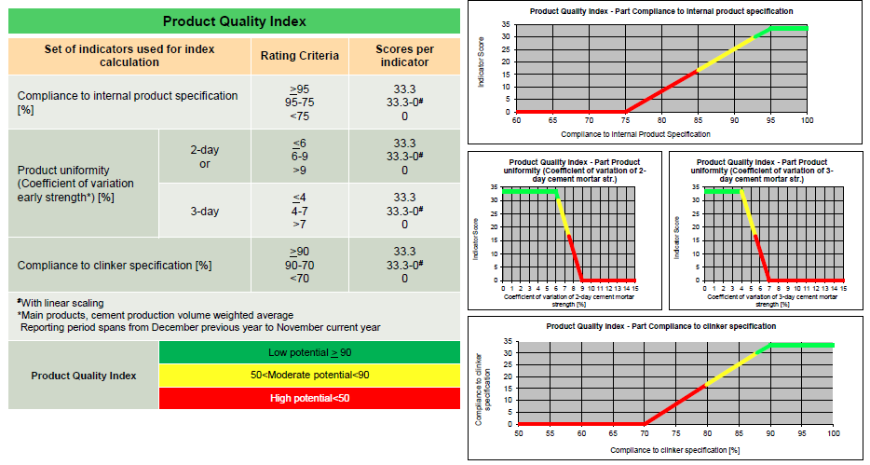
Specific targets and the respective score for the Product Quality Index
12

Slide 13
Product Quality Index development 2009 - 2014
New calculation in 2014

Slide 14
Manufacturing quality targets and KPIs: Product uniformity
Legacies | Parameters | Targets
Holcim
 | 2-days strength CoV | ≤ 6%
 | 3-days strength CoV | ≤ 4%
 | 28-days strength CoV (old) | ≤ 3%
Lafarge
 | 28-days standard deviation | Classes A-E (example EN) < 1.6 1.6 – 2.0 2.0 – 2.5 2.5 – 3.0 > 3.0
14

Slide 15
Compliance to Clinker Specifications
Legacy Holcim:
The indicator measures the percentage of clinker volume where all clinker specifications are fulfilled
Specifications have to be fulfilled on two levels: First level (mandatory)
Comparison with legacy Lafarge:
Lime saturation range ± 2.5 corresponds to CUI variance class C
Free lime range of 1.5 corresponds to FLUI class C
Free Lime |  |  | Lime saturation
 | Acceptance range |  |  | Acceptance range
 | Min. | Max. |  | Min. | Max.
T_{free lime} | T_{free lime} -0.5 | T_{free lime} +1.0 | T_{limesaturation} | T_{limesaturation} – 2.5 | T_{limesaturation} +2.5
15

Slide 16
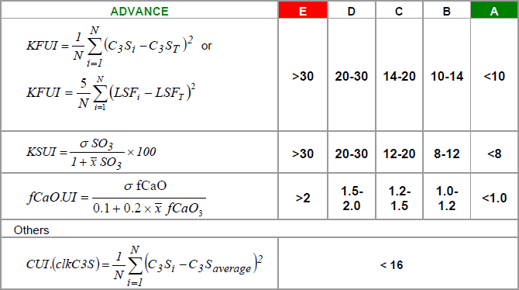
Legacy Lafarge kiln feed and clinker uniformity indicators
By definition, calculated based on 1 sample per day at specific time: For example, 8am clinker sample, 6am kiln feed sample
Kiln feed uniformity calculated vs Target, others vs Average

Slide 17
Excellent … and poor uniformity
Plant A
Conformity 91 % (LS and CaOf)
Plant B
Conformity 34 % (LS and CaOf)
LS
CaOf
2-hourly testing frequency, 1 month period
17

Slide 18
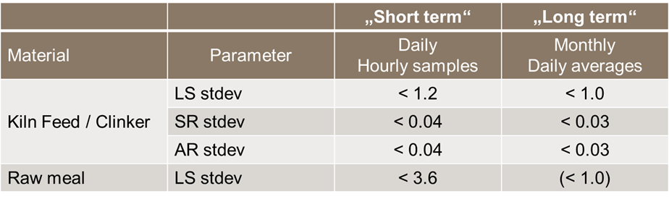
Legacy Holcim uniformity targets: Kiln feed (and clinker)
*
* For plants with pre-blending systems
The ultimate goal is to achieve a high chemical uniformity of clinker
18

Slide 19
Compliance to Clinker Specifications (cont.)
Second level (plant specific selection, not mandatory)
Specifications for C₃A, Na₂O eq., SO_{3,} F and for other plant relevant minor elements (e.g. MgO, P₂O₅, etc.)
They have to be specified in case they are relevant to meet the Internal Product Specifications and related National Cement Standards (e.g. low alkali cements, sulfate resistant cements, cements made with mineralized clinker).
Following one example:
C₃A |  |  | Na₂O-equivalent
 | Acceptance range |  |  | Acceptance range
 | Min. | Max. |  | Min. | Max.
7.0 | 5.0 | 8.0 | 0.50 | n.d. | 0.6
19

Slide 20
Additional criteria for clinker/raw meal uniformity
Clinker | Daily (hourly samples) | Monthly (daily averages)
CaO f Range Min.- Max. (%) | ≤ 1.5 | ND
SO₃ C.o.V. | ≤ 10%* | ND
K₂O C.o.V | ≤ 10%* | ND
Raw Meal | Daily (hourly samples) | Monthly (daily averages)
Fineness R90 C.oV.* | ≤ 5% | ND
* MPR target for excellence
20

Slide 21
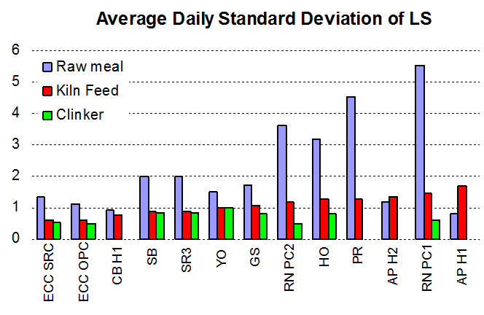
Uniformity Indicators – Benchmarks
Plant No. | Std LS Kiln feed | Blending factor
1 | 0.61 | 2.2
2 | 0.62 | 1.8
3 | 0.79 | 1.2
4 | 0.89 | 2.2
5 | 0.89 | 2.2
6 | 1.01 | 1.5
7 | 1.07 | 1.6
8 | 1.19 | 3.0
9 | 1.26 | 2.5
10 | 1.28 | 3.5
11 | 1.34 | 0.9
12 | 1.45 | 3.8
13 | 1.69 | 0.5
2 3 4 5 6 7 8 9 10 11 12 13
Plant No.
21

Slide 22
Evaluation of uniformity

Slide 23
Evaluation of short term and long term variability over one month
 |  |  |  |  | 01.08.2015 | 02.08.2015 | 03.08.2015 | 04.08.2015 | 05.08.2015 | 06.08.2015
 | CoV | Average | Stdev |  | Date | Date | Date | Date | Date | Date
 |  |  |  |  | 42217 | 42218 | 42219 | 42220 | 42221 | 42222
Long term | 1.74% | 100.94 | 1.76 | x LS | 100.31 | 100.11 | 100.03 | 99.79 | 99.94 | 101.11
Short term |  | 3.55 |  | s LS | 1.34 | 1.26 | 5.23 | 4.69 | 2.56 | 1.24
 |  |  |  | cov LS | 1.33% | 1.26% | 5.23% | 4.70% | 2.56% | 1.23%
 |  |  |  | min LS | 98.01 | 98.18 | 89.14 | 92.39 | 95.69 | 99.41
 |  |  |  | max LS | 102.18 | 102.25 | 108.83 | 107.73 | 104.89 | 103.34
 |  |  |  | n LS | 15 | 9 | 11 | 8 | 13 | 11
Long term | 2.99% | 2.45 | 0.07 | x SR | 2.49 | 2.49 | 2.49 | 2.43 | 2.50 | 2.46
Short term |  | 0.06 |  | s SR | 0.04 | 0.04 | 0.11 | 0.12 | 0.04 | 0.03
 |  |  |  | cov SR | 1.62% | 1.45% | 4.45% | 4.83% | 1.69% | 1.31%
 |  |  |  | min SR | 2.41 | 2.44 | 2.32 | 2.26 | 2.41 | 2.39
 |  |  |  | max SR | 2.56 | 2.55 | 2.66 | 2.55 | 2.56 | 2.50
 |  |  |  | n SR | 15 | 9 | 11 | 8 | 13 | 11
Long term | 1.88% | 1.47 | 0.03 | x AR | 1.45 | 1.47 | 1.47 | 1.50 | 1.43 | 1.45
Short term |  | 0.06 |  | s AR | 0.06 | 0.07 | 0.04 | 0.06 | 0.04 | 0.01
 |  |  |  | cov AR | 3.98% | 4.71% | 3.04% | 4.28% | 2.59% | 0.85%
 |  |  |  | min AR | 1.38 | 1.36 | 1.39 | 1.43 | 1.35 | 1.43
 |  |  |  | max AR | 1.58 | 1.60 | 1.53 | 1.60 | 1.49 | 1.47
 |  |  |  | n AR | 15 | 9 | 11 | 8 | 13 | 11
23

Slide 24
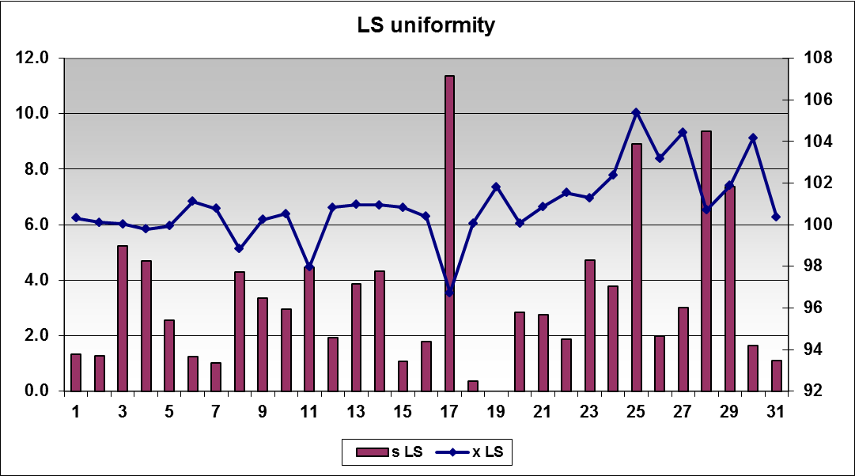
Evaluation of short term and long term variability
s LS
x LS
red: LS standard deviation
blue: average LS

Slide 25
Short term and long term variability calculated over one month
Short term variability:
Average of the daily standard deviation (σ) over one month (e.g. on hourly or two-hourly samples)
Particularly relevant for equipment performance
Long-tem variability:
Standard deviation of the daily average values (σ) over one month
Particularly relevant regarding product quality
25

Slide 26
Evaluation of uniformity: Considerations
Short term variation (standard deviation) should be only calculated with more than 4 (better 6) samples.
Long term variation is dependent on the number of samples used to calculate the daily average
Change of targets will have effect on long term variation
If there is a clear change of targets, the time periods could be split
Long term and short term variation do not necessarily need to correlate
26

Slide 27
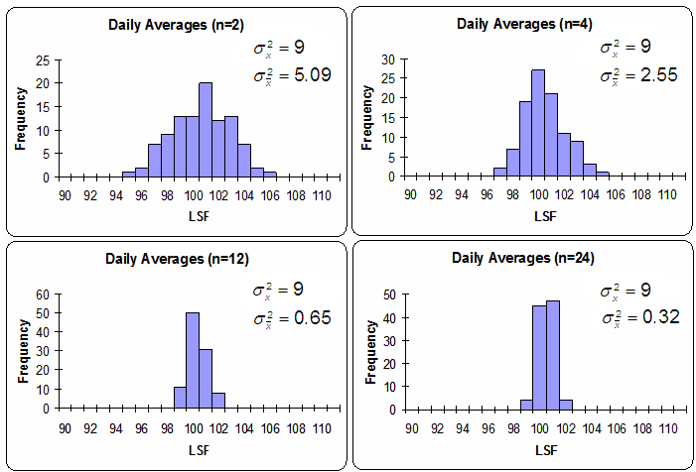
Long term uniformity: Effect of taking averages
All these averages come from the sample population!
27

Slide 28
Quality Data Analysis
Detailed quality data analysis serves to find root causes for excessive variability. This, in turn, is the basis to define measures for improvement.
Average values and standard deviation can point towards existing variability problems, but are generally not sufficient to derive causes.
Effective tools are graphical representations, supported and complemented by statistical tools.
28

Slide 29
Variability Assessment: Plant Example
Plant subject to heavy coating, ball and ring formation, as well as instable coating, attributed to chemical variations in kiln feed
Plant also wants to rationalize laboratory work
29

Slide 30
Variability Assessment of LS: Plant Example
individual data points
LS of hourly samples in raw meal
std = 1.9
averages
daily averages
std = 0.6
standard deviation
standard deviations over 1 day
std = 1.3 (average)
30

Slide 31
Variability Assessment of SR: Plant Example
individual data points
SR of hourly samples in raw meal
std = 0.30
averages
daily averages
std = 0.29
standard deviation
standard deviations over 1 day
std = 0.08 (average)
31

Slide 32
Variability Assessment: Plant Example
32

Slide 33
Variability Assessment: Plant Example
33

Slide 34
Variability Assessment: Plant Example
Assessment
Short term variability is good; LS of raw meal can be well controlled with preblended limestone and preblended clay
Temporary disturbances due to stockpile endcones
Step changes in SR due to different compositions of successive preblending stockpiles
Recommendation
Improve deposit knowledge to better manage SR; PGNAA possible, but no benefit for endcones and rationalization
Automate raw meal control; option to extend automation to other areas: helps for endcones, permits rationalization
Realized: Local on-line raw meal control (FLS On-Stream) (not optimal for rationalization)
34

Slide 35
Time plot provides insight into variability pattern
stable
Trend
out of control
35

Slide 36
Influences of fuel mix on clinker uniformity
36

Slide 37
Classification: Cycles and trends
Normal behavior
Trends
Cycles
37

Slide 38
Classification: Cycles and trends
Runs
Expected number of runs = (n + 2) / 2 (process under control)
Relevance for raw meal control:
Too long periods above or below a given target value (e.g. lime saturation) can no longer be blended out in the homogenization silo. Sufficiently frequent cross-overs of target line is desirable.
runs
median
38

Slide 39
Classification: Cycles and trends
Mean square successive difference
39

Slide 40
Classification: Cycles and trends
Indicators
 | MSSD-Stdev | Actual runs
Normal behavior | ≈ Stdev | ≈ expected runs
Trends | < Stdev | << expected runs
Cycles | > Stdev | >> expected runs
40

Slide 41
Process Behavior: Plant Example
Situation
New production line
On-line raw meal control with local system (Polysius AOT), permitting XRF-analysis and feeder adjustments in intervals as short as 10 minutes
Components: Limestone, clay, fly ash, mill scale
Guarantee tests for achieving blending performance Procedure: every hour, the average LS over the past 2 hours is determined. 95 % of these values have to be within target LS ± 2 % (same for SR and AR)
41

Slide 42
Process Behavior: Plant Example
Std = 7.2
MSSD-std = 2.3 (2.3 << 7.2
Runs = 7 (7 << 27)
Process subject to trends
42

Slide 43
Process Behavior: Plant Example
% clay
set-point (%) clay
actual (%) clay
set-point (%) limest.
actual (%) limest.
43

Slide 44
Process Behavior: Plant Example
Assessment
Swing (trend) is caused by slow response of feeders
Complex system of overriding loops and feeder links are preventing the immediate application of the requested feeder set-points
Direct feed of clay from Bedeschi stockpile, without intermediate feed bin (stickiness). Clay respond particularly slow.
Solutions
Elimination of overriding loops and tuning of blending program by plant process engineer and supplier. Significant improvements made.
Improvements of clay feed difficult.
44

Slide 45
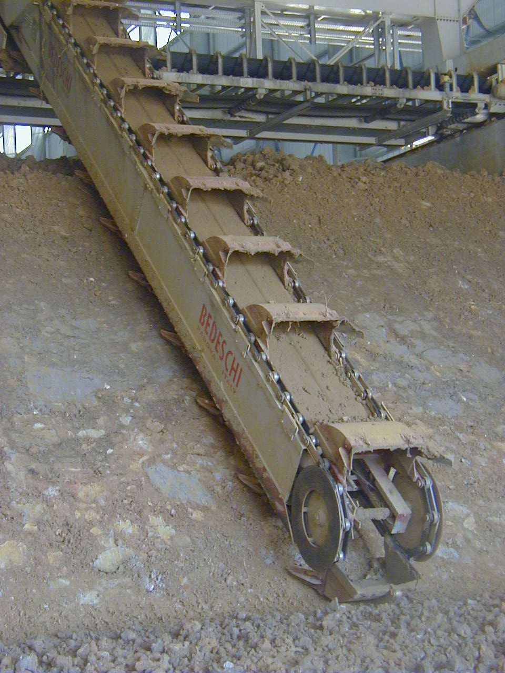
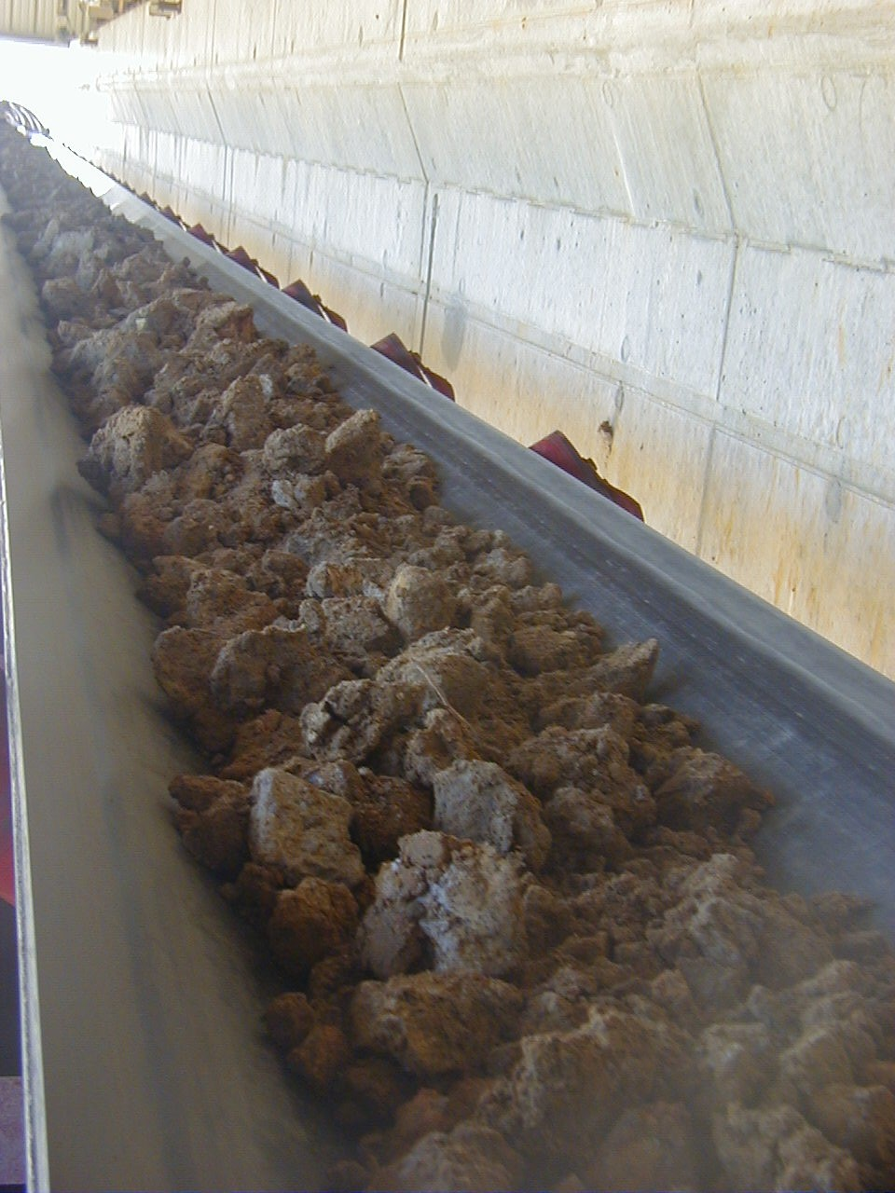
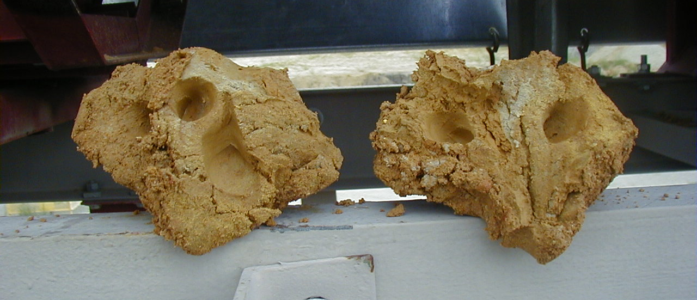
Clay feed system
45

Slide 46
Statistical process control: Basics
Statistically, points should be in between
and
μ is mean σ is standard deviation
Idea is based on probability theory
Only 0.3%, out of 3⋅σ control limit (normal distribution)
Rare event → interpret as out of control (something wrong)
-3σ
μ
+3σ
99.7%
Points are unlikely to be out of (μ ± 3⋅σ) range … If we can assume normal distribution
46

Slide 47
X-Chart: Control limits for individual values
Control limits:
Estimation of parameters:
Expected mean
Standard deviation: Either global variability
or local variability (using the range of two values)
47

Slide 48
Is this process under control?
48

Slide 49
Example: X-chart
49

Slide 50
Process capability: Factors
Sample Size n
Factors for
Factors for Standard Deviation or Sigma
d₂
Sample Size n
Average
A₂
Range
D₃
D₄
2
1.880
.0
3.268
1.128
2
3
1.023
.0
2.574
1.693
3
4
.729
.0
2.282
2.059
4
5
.577
.0
2.114
2.326
5
6
.483
.0
2.004
2.534
6
7
.419
.076
1.924
2.704
7
8
.373
.136
1.864
2.847
8
9
.337
.184
1.816
2.970
9
10
.308
.223
1.777
3.078
10
11
.285
.256
1.744
3.173
11
12
.266
.284
1.717
3.258
12
13
.249
.308
1.692
3.336
13
14
.235
.329
1.671
3.407
14
15
.223
.348
1.652
3.472
15
50

Slide 51
Cost Impact of Insufficient Uniformity

Slide 52
Potential benefits resulting from improved kiln feed uniformity
Increased production volume
Lower specific thermal energy consumption
Reduction of off-spec clinker volume
Lower specific consumption of refractory materials
Improved clinker reactivity
Reduced specific energy consumption for cement grinding
52

Slide 53
Estimation of financial benefits resulting from improved uniformity
Polysius: 1-2% more energy efficient clinker and cement production:
1 mio t of clinker with 3.5 GJ/t, 3 EUR/GJ for thermal energy: 1.5 % energy savings translates into yearly savings of 160’000 EUR
1.5 mio t of cement with 100 kWh/t, 0.15 EUR/kWh for electrical energy: 1.5 % energy savings translates into yearly savings of 340’000 EUR
FLS: Reduction of specific heat consumption by 100 MJ/t of clinker by improvement of LS standard deviation of kiln feed by 1:
1 mio t of clinker with 0.1 GJ/t reduction, 3 EUR/GJ for thermal energy: improved uniformity translates into yearly savings of 300’000 EUR
53

Slide 54
Example: Specific thermal energy consumption
Heat consumption
versus kiln feed quality
data from FLSmidth study:
a 1 % increase in LSF std dev = +25 kcal/kg
1 mio t of clinker with 0.1 GJ/t reduction, 3 EUR/GJ for thermal energy: Improved uniformity translates into yearly savings of 300’000 EUR
54

Slide 55
Specific heat consumption and s(LS) for three (random) plants
Very poor correlations are observed. Heat consumption is affected by many other parameters.
However, positive correlation is indicated
Similar order of magnitude as in FLS study (100 kJ/t per 1 point s(LS))
55

Slide 56
Concept of Defining Minimum Requirement
Avg 2
S = 1.5
Avg 1
S = 2.5
Minimum
Quality
Requirement
a = 5 %
Non Quality
Costs
Quality Parameter
56

Slide 57
Non-Quality Cost: Impact Kiln Feed Variability
Situation
Plant with 4-stage preheater reports the experience that the specific heat consumption increases by 15 MJ/t clinker for an increase in lime saturation by one unit.
Assuming a minimum requirement of 91 LS, the savings related to a decrease of standard deviation from 2.5 to 1 LS can be calculated.
See also Report MA 94/3198/E
57

Slide 58
Non-Quality Costs Related to Product Variability
Clinker Burning
Minimum Requirement
91.5 % LS
Reduction in Variability (STD)
2.5 LS to 1 LS
Specific Savings
15 MJ /t. LS
Absolute Savings
46 MJ /t
Annual Clinker Production
0.8 Mio t
Energy Costs per Unit
2.5 USD /GJ
Savings per Year
92'000 USD
58

Slide 59
Non-Quality Cost: Impact Cement Variability
OPC Type I/II
95% = +/- 2 s
actual values
Average 43.8 MPa
Std Dev 2.3 MPa
CoV 5.2 %
% Observations
28 d strength [MPa]
95% = +/- 2 s
18
– 2 MPa
Holcim target
CoV 3.0 %
Std Dev 1.3 MPa
16
14
12
% Observations
10
8
Average 41.8 MPa
6
4
2
0
36.0
37.0
38.0
39.0
40.0
41.0
42.0
43.0
44.0
45.0
46.0
47.0
48.0
49.0
50.0
51.0
52.0
28 d strength [MPa]
10.11.2010
59

Slide 60
Non-Quality Cost: Impact Cement Variability
Plant produces Type I/II and Type III from same clinker, cements differ in fineness only. Relevant data from ATR:
 | Type I/II | Type III | Δ
Fineness Blaine [cm²/g] | 3825 | 5120 | 1295
Specific energy cons. [kWh/t] | 48.1 | 70.9 | 22.8
28 d strength [MPa] | 42.5 | 50.4 | 7.9
⇨ 164 Blaine/MPa
⇨ 1.76 kWh/t.100 Blaine
60

Slide 61
Impacts of Cement Uniformity
Example from MPR:
2 MPa ≈ 300 Blaine
Type III
Type I
Estimation: 300 Blaine ≈ 5.2 kWh/t
61

Slide 62
Better uniformity allows for more flexibility to react to market needs
28 Days Strength in Mpa
65
Conformity Range for
62.5
Average Strength
60
55
Better Quality / Cost Ratio
Flexibility in Product Diversification
50
Better Competitiveness
45
42.5
40
1
2
3
4
5
6
7
Standard Deviation in Mpa
62

Slide 63
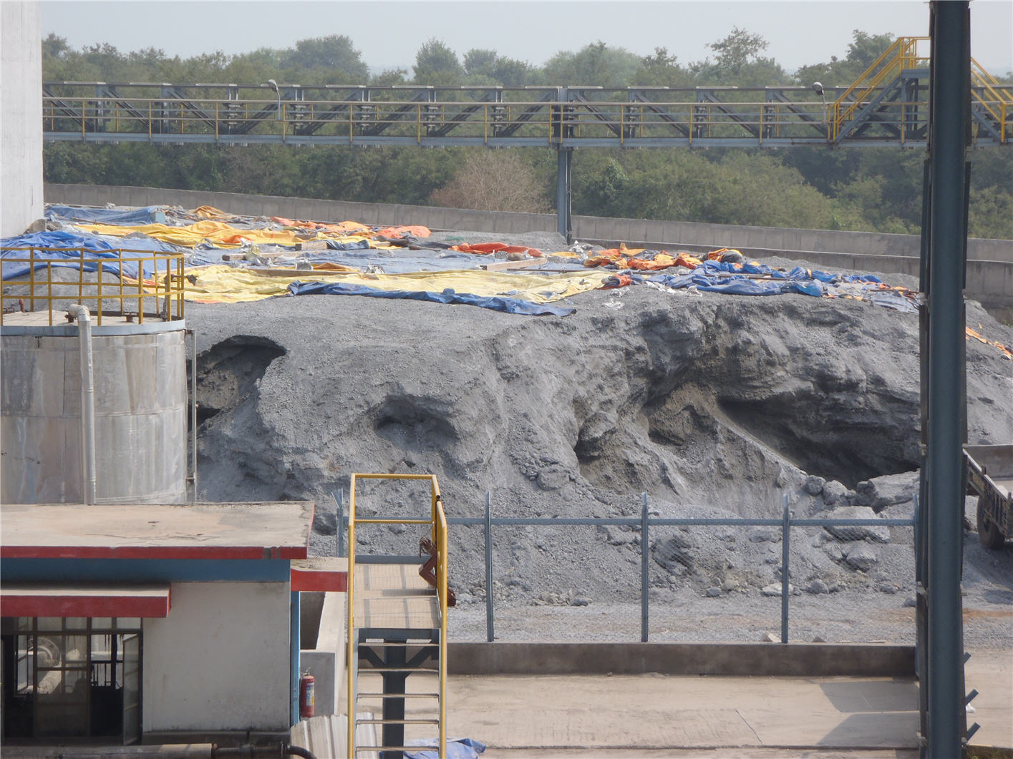
Costs related to outside storage of clinker
Costs of additional handling
Pre-hydration of clinker: Loss of reactivity, harder to grind.
→ Increase of specific grinding energy, higher clinker factor
63

Slide 64
Costs related to outside storage of clinker: Example
Situation
Plant A stocks 50’000 t clinker outside during the rainy season because of low cement demand. Moisture contents increases to 5 %. Clinker needs to be crushed.
Plant B is located in a dry climate. Outdoor clinker is not hydrated; nevertheless, costs arise due to double handling and need to grind to higher Blaine.
(example from Report MA 94/3190/E)
64

Slide 65
Costs Associated with Outdoor Stored Clinker
65

Slide 66
How to improve uniformity

Slide 67
Clinker and Cement uniformity is the result of all steps of manufacturing
QUARRY
CEMENT
GRINDING
CLINKER/ CEMENT
PREBLENDING
CLINKER
BURNING
RAW MILL /
HOMOGENIZATION
67

Slide 68
Measures to Improve Uniformity
Process | Quality Control | Process
Quarrying
Storage/ Preblending
Raw meal grinding
Homogeni-zation
68

Slide 69
Measures to Improve Uniformity
Process | Quality Control | Process
Quarrying | Blast drill hole analysis QuarryMaster | Selective quarrying
Storage/ Preblending | Bulk Material Analyzer (PGNAA) | Preblending beds Optimization end cones
Raw meal grinding | Frequent raw meal control On-line control by PGNAA ahead of mill On-site XRF- system Central lab automation | Upgrade feed systems Modify dust handling
Homogeni-zation | Frequent kiln feed control Autom. kiln feed control (central lab automation) | Kiln dust handling (compound vs direct operation) Maintenance of blending silos Silo operation
69

Slide 70
Measures to Improve Uniformity
Process | Quality Control | Process
Fuel preparation
Clinker burning
Cement grinding
70

Slide 71
Measures to Improve Uniformity
Process | Quality Control | Process
Fuel preparation | Frequent fineness control | Regular AF availability and dosage
Clinker burning | Frequent free lime control Autom. free lime control On-site free lime analyzer XRD in central lab Autom. clinker phase control (Rietvelt analysis) Hot meal control | Regular kiln feed and fuel feed rate Kiln Expert Control
Cement grinding | Frequent fineness control Autom. fineness control On-site fineness analyzer fineness in central lab Autom. chemical control central laboratory | Preblending of MIC Individual feed systems for each constituent Upgrade feed systems
71

Slide 72
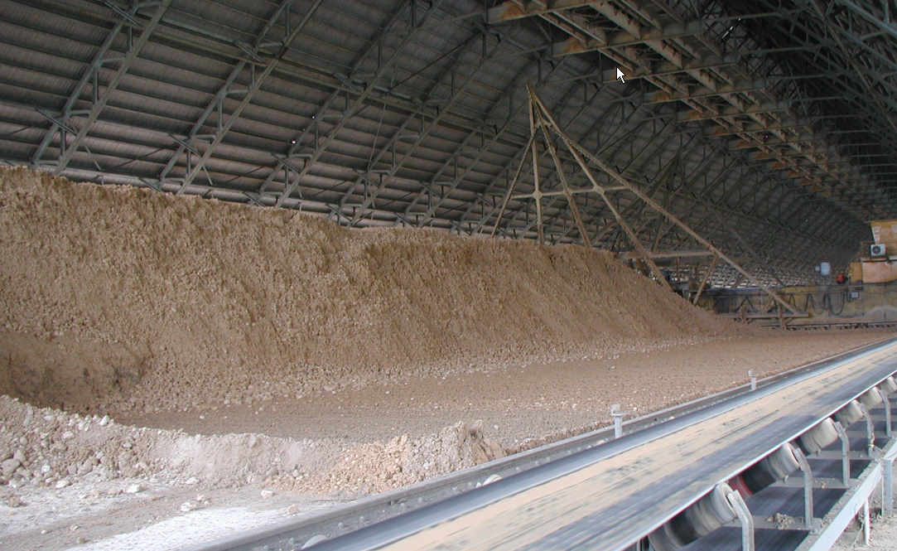
Uniformity is affected by incomplete filling of pre-blending piles
72

Slide 73
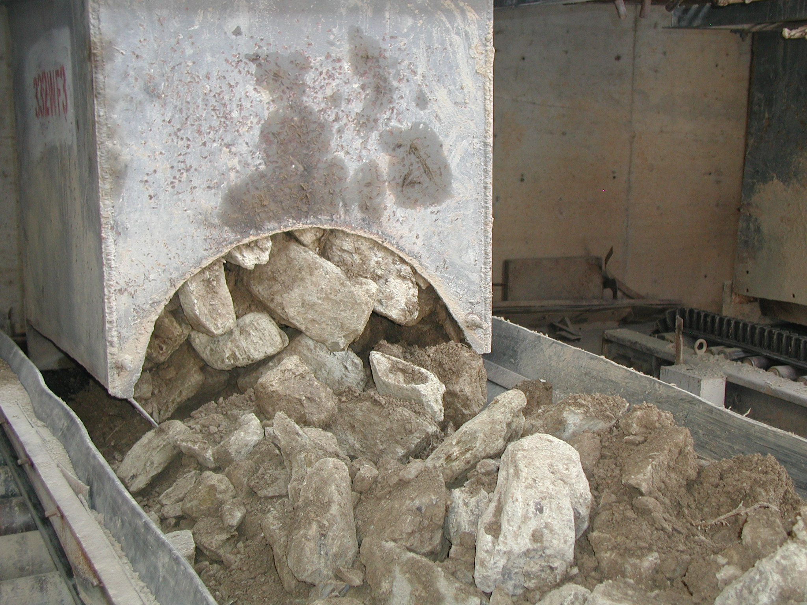
Inadequate feed size causes feeder blockages
73

Slide 74
Quality Control Aspects of Uniformity

Slide 75
Automation in quality control helps to improve uniformity
Increased product quality and reduced operational costs through improved uniformity
High sampling frequency
More sampling points
Round-the-clock control
High standard of sample preparation and analysis
Measurement of relevant parameters at high frequency
Ideally “real time” / At earliest opportunity
Fast reaction (process control)
Automated QC systems need an appropriate control software
Liberation of personnel from routine work for more demanding tasks – Especially shift laboratory
75

Slide 76
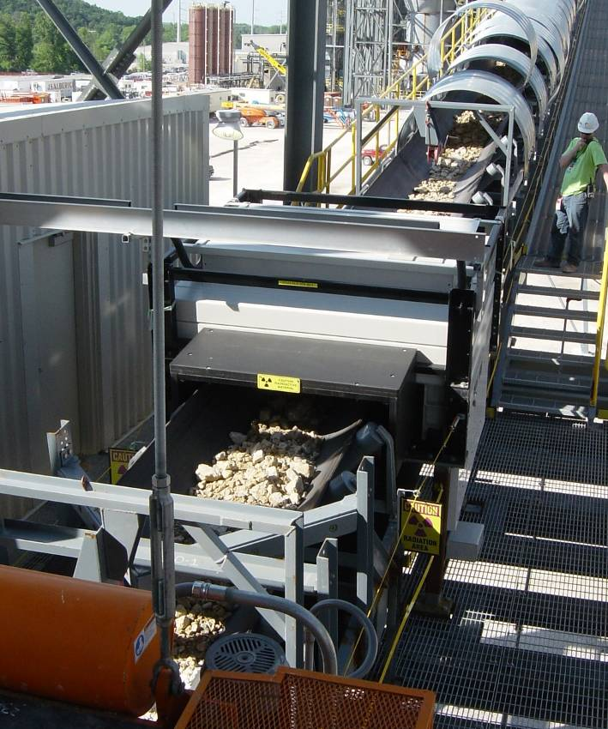
Examples: PGNA Analyzer on Raw Mill Feed
Advantages
Installed on mill feed belt
<5 min control interval
Limitations
All components have to be on mill feed belt
Space requirement
Appropriate for
Heterogeneous raw components
Mill systems with long retention time
Very large capacity mills
USD 350,000 approximately
76

Slide 77
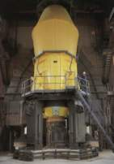
Typical setup for raw mix control
Pre
Mix
Fe
Al
Si
PGNAA
Electronic
Enclosure
CCM
PLC
Raw Mill
Control
Software
Balance
Operator console
77

Slide 78
Example: Improved uniformity through PGNAA control
78

Slide 79
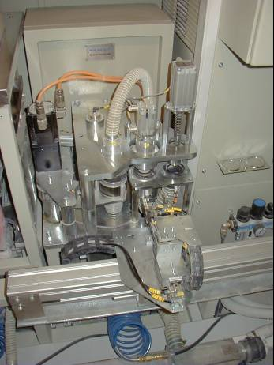
Examples: Polysius AOT Analyzer (XRF)
Advantages
Approx. 10 min control interval
Optimum sample preparation
Mechanically complex, but “high quality” design
Limitations
Higher price
Application
2 systems installed (HH, JO)
Experience
High availability; well performing system
No longer marketed by Polysius
USD 300,000 approximately
79

Slide 80
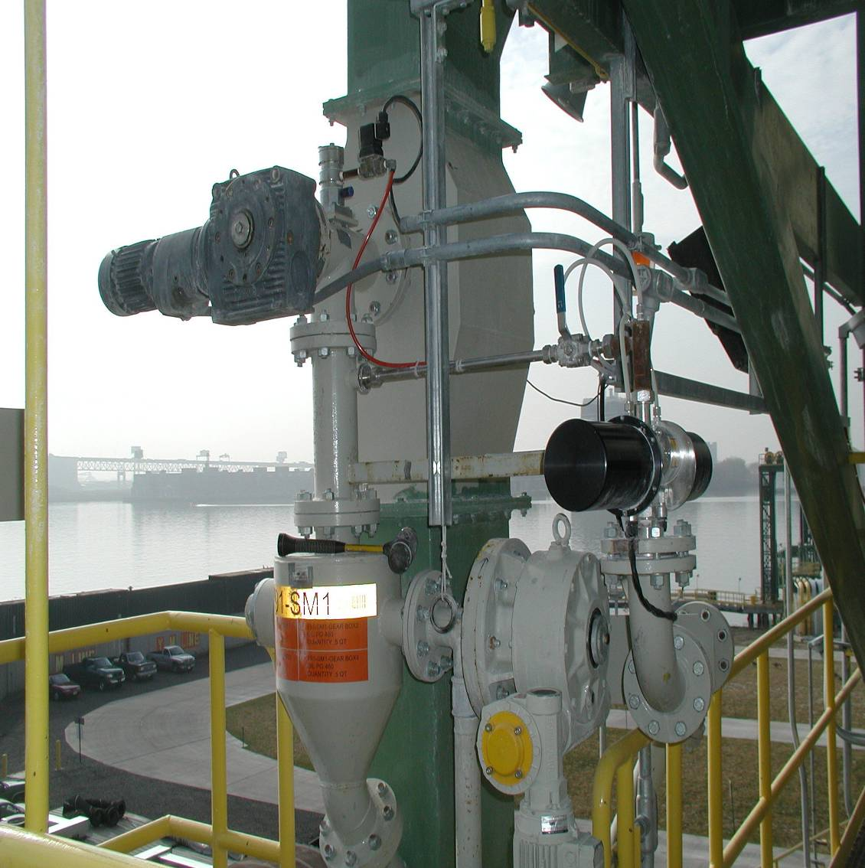
Examples: Cement Fineness with Malvern/Insitec
Laser granulometer systems are established solutions in the laboratory.
Online systems: Real-time information for process control (e.g transition between two products)
Online systems from Malvern (Insitec) and Sympatec (MYTOS).
Limited applications in Holcim (15 – 20 units installed).
Preferred technology by HGRS, though cost/ benefit often not evident. Multiple mill units render concept expensive.
Primary sampling
Analyzer
Secondary sampling
Material return
80

Slide 81
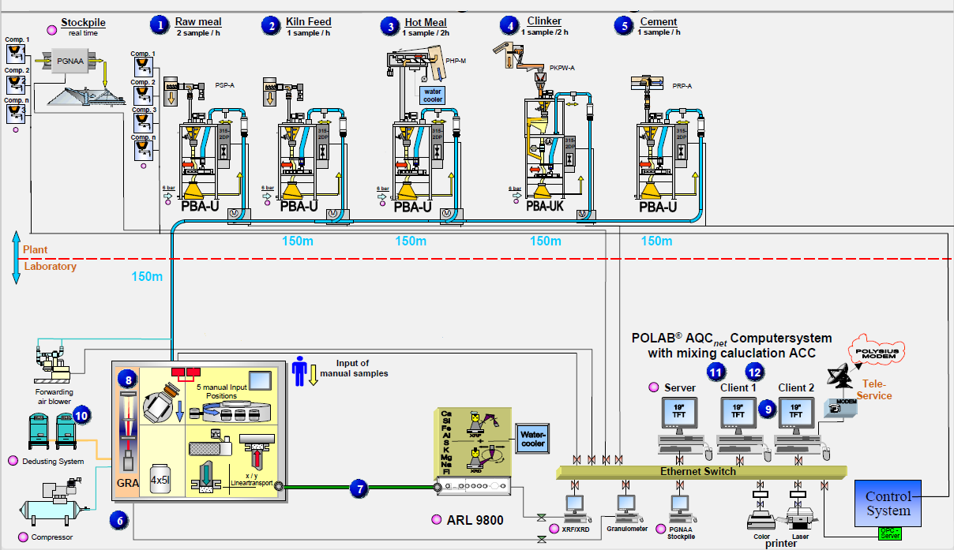
Automated laboratories help to increase sampling and analysis frequency
Automated sampling and dispatch
Pneumatic sample transport
Control Software
Integrated analytical equipment
Automated sample reception and preparation
81

Slide 82
Centralized Control Systems
X-ray room
(15-20 sqm)
FLS RoboLab
Sample prep room
(30-40 sqm)
QCX/RoboLab
82

Slide 83
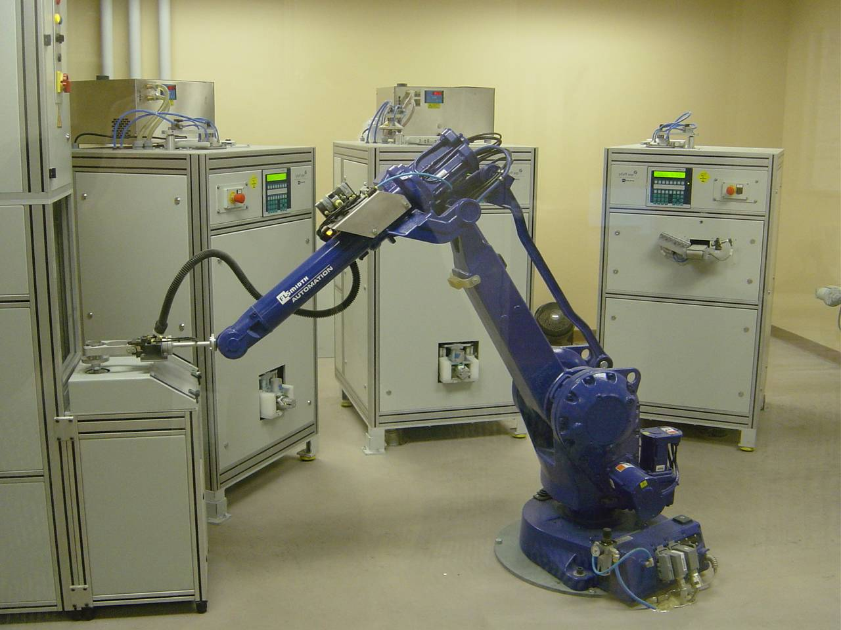
FLS RoboLab at St. Genevieve
83

Slide 84
Summary and Conclusions

Slide 85
Summary and Conclusions
High material uniformity is essential for high equipment performance. Deficiencies cause appreciable non-quality costs and can impair competitiveness.
Quality control and quality data do not only serve for on-going control, but also to analyze process performance.
It is the task of the Process Engineer, in cooperation with the quality responsible, to investigate improvement potentials and to develop solutions. Measures both in quality control and process may be required.
Powerful automated quality control technologies are available; their cost-effectiveness, however, needs to be evaluated carefully.
85

